Slide 1
Match-A-Quote
Given a quote, find the picture that best matches the quote.

Slide 2
It’s the mind that sees, not the eyes.
We encounter a lot of quotes daily.
But Most of them are in plain dull text.
Pictures are more appealing to us.
So,
What if we want to express the quote with a picture ?

Slide 3
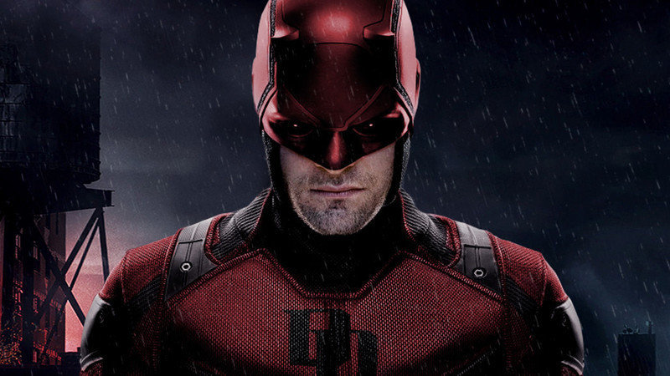
It’s the mind that sees, not the eyes.

Slide 4
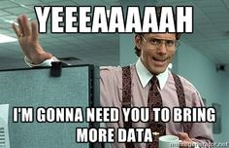
The DataSets
Quotes DataSet
Attributes: [Category, Quote,Tags]
Images DataSet
Attributes: [Category, Image Name,Tags]

Slide 5
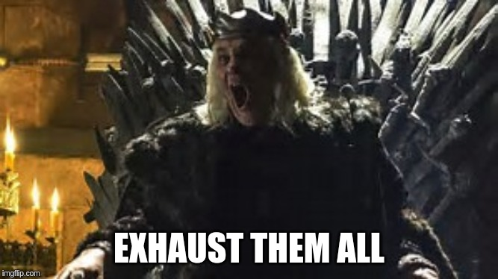
Algorithm
Search all images for a given quote and
If a Category Matches : score1 : 5 Points
If a Tag Matches : score2 : 1 Point (Each)
Strict Matching ( Less But Relevant Images )
If score1 >= 5 and score2 > 0
Loose Matching ( More But irrelevant Images )
If score1 + score2 > 0
Display the Top Results!

Slide 6
Demo
loading...

Slide 7

Thanks!
Team Members:
Nawab Alam (2018201030)
Kishan Singhal (2018201023)
Rajat Dua (2018201066)
Shashi Jangra (2018202001)

